Slide 1
selenium
Selenium training
Author : Azhar Wahab
UID : U61976

Slide 2
Selenium webdriver
WebDriver is a web automation framework that allows you to execute your tests against different browsers.
Following programming languages are supported by WebDriver
Java
.Net
PHP
Python
Perl
Ruby

Slide 3
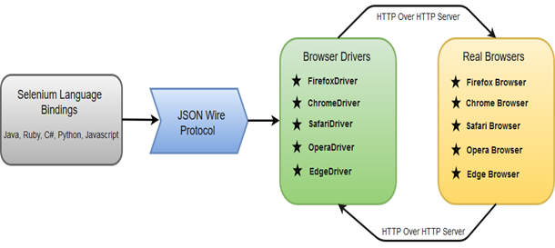
Selenium WebDriver- Architecture

Slide 4
Selenium webdriver client
The latest version of Selenium Standalone is 3.141.59
Download link for Selenium Standalone
https://www.seleniumhq.org/download/

Slide 5
OPEN chrome browser
Download chrome driver suitable for the chrome browser.
Execute the below code.
String exePath = "D:\\Selenium jars\\chromedriver.exe";
System.setProperty("webdriver.chrome.driver", exePath);
WebDriver driver = new ChromeDriver();
driver.get("https://www.google.co.in/");

Slide 6
OPEN IE browser
Download IE driver for the IE browser.
Protected Mode settings are the same for all zones.
Zoom level should be set 100 %.
Execute the below code.
String exePath = "D:\\Selenium jars\\chromedriver.exe";
System.setProperty("webdriver.chrome.driver", exePath);
WebDriver driver = new InternetExplorerDriver ();
driver.get("https://www.google.co.in/");

Slide 7
WebDriver Browser Commands
Get Command - driver.get(URL);
Get Title Command - driver.getTitle();
Get Current URL Command - driver.getCurrentUrl();
Get Page Source Command - driver.getPageSource();
Close Command - driver.close();
Quit Command - driver.quit();
Maximize window - driver.manage().window().maximize();

Slide 8
Browser Navigation Commands
Navigate To Command - driver.navigate().to(appUrl);
Forward Command - driver.navigate().forward();
Back Command - driver.navigate().back();
Refresh Command - driver.navigate().refresh();

Slide 9
Element identification By ID
id(String id) : By – This is the most efficient and preferred way to locate an element, as most of the times IDs are unique. It takes a parameter of String which is a Value of ID attribute and it returns a BY object to findElement() method.
Command – driver.findElement(By.id(“Element ID”));
With this strategy, If no element has a matching id attribute, a NoSuchElementException will be raised.
Practise link - https://www.makemytrip.com/flights/

Slide 10
Element identification By name
name(String name) : By – This is also an efficient way to locate an element but again the problem is same as with ID that UI developer make it having non-unique names on a page or auto-generating the names. It takes a parameter of String which is a Value of NAME attribute and it returns a BY object to findElement()method.
Command – driver.findElement(By.name(“Element NAME”));
With this strategy, the first element with the name attribute value matching the location will be returned. If no element has a matching name attribute, a NoSuchElementException will be raised
Practise link (First name) - http://toolsqa.com/automation-practice-form/

Slide 11
Element identification By ClassName
className(String className) : By – This finds elements based on the value of the CLASS attribute. It takes a parameter of String which is a Value of CLASS attribute and it returns a BY object to findElement() method.
Command – driver.findElement(By.className(“Element CLASSNAME”));
If an element has many classes then this will match against each of them.
Practise link(Gmail)- https://www.google.co.in/

Slide 12
Element identification By CSSSELECTOR
cssSelector(String className) : By – This finds elements based on the value of the cssSelector attribute. It takes a parameter of String which is a Value of CLASS attribute and it returns a BY object to findElement() method.
Command – driver.findElement(By. cssSelector(“Element CSSSELECTOR”));
If an element has many classes then this will match against each of them.
Practise link(Gmail)- https://www.google.co.in/

Slide 13
Element identification By tagname
tagName(String name) : By – With this you can find elements by their TAGNAMES. It takes a parameter of String which is a Value of TAG attribute and it returns a BY object to findElement() method.
Command – driver.findElement(By.tagName(“Element TAGNAME”));
Locating Element By Tag Name is not too much popular because in most of cases, we will have other alternatives of element locators. But yes if there is not any alternative then you can use element’s DOM Tag Name to locate that element in WebDriver.

Slide 14
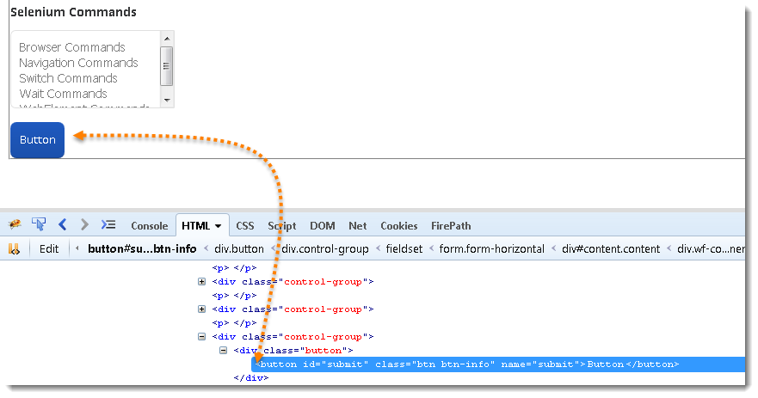
Tagname example
WebElement element = driver.findElement(By.tagName("button"));
// Action can be performed on Input Button element
element.submit();

Slide 15
By LinkText & PartialLinkText
linkText(String linkText) : By – With this you can find elements of “a” tags(Link) with the link names. Use this when you know link text used within an anchor tag. It takes a parameter of String which is a Value of LINKTEXT attributeand it returns a BY object to findElement() method.
partialLinkText(String linkText) : By – With this you can find elements of “a” tags(Link) with the partial link names.
Command – driver.findElement(By.linkText(“Element LINKTEXT”));
Command – driver.findElement(By.partialLinkText(“Element LINKTEXT”));
Practise link(Gmail)- https://www.google.co.in/

Slide 16
Absolute xpath
It is used to identify an element.
The iteration starts from the root of html.
It is very difficult to develop an absolute xpath for an webelement.
Sample absolute xpath is given below for Gmail link in google home page.
html/body/div[1]/div[3]/div/div/div/div/div/div/a

Slide 17
Relative XPath
It is also used to identify a webelement .
It can start its search at any point of the HTML .
Sample relative xpath is given below for Gmail link in google home page.
//a[@class='gb_P' and @data-pid='2']

Slide 18
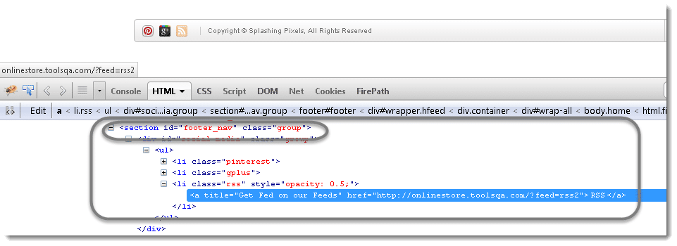
XPATH Techniques
Relative xpath: //*[@id=’social-media’]/ul/li[3]/a

Slide 19
XPATH Techniques-Partial XPath | Contains Keyword
<div class="profile_cont" itemtype="http://schema.org/Article" itemscope=""> <img src="http://toolsqa.wpengine.com/wp-content/uploads/2014/02/Profile.jpg?51a507" itemprop="image"> </div>
//img[contains(@src,’Profile’)]

Slide 20
XPATH Techniques-Partial XPath | Starts-With Keyword
<img alt="Visit Us On Linkedin fgofoghsohiofhgsiohiodghiohsiohsghdoioiog" style="border:0px;" src="http://toolsqa.wpengine.com/wp-content/uploads/2014/04/linkedin.png">
//img[starts-with(@alt,’Visit Us On Linkedin’)]

Slide 21
XPATH Techniques-Partial XPath | Text Keyword
I’M <span itemprop="author" itemscope="" itemtype="http://schema.org/Person"> <b itemprop="name">LAKSHAY SHARMA</b> . I’M A <b>TEST AUTOMATION ENGINEER</b> </span>
//*[text()=‘LAKSHAY SHARMA’]

Slide 22
Following Sibling
The following-sibling axis selects those nodes that are siblings of the context node (that is, the context node and its sibling nodes share a parent node) and which occur later in document order than the context node.
Syntax: //select[@id='month']/following-sibling::* //select[@id='month']/following-sibling::select/

Slide 23
Preceding Sibling
The preceding-sibling axis selects those nodes which are siblings of the context node (that is, the context node and its sibling nodes share a parent node) and which occur earlier in document order than the context node.
//select[@id='day']/preceding-sibling::select/ //select[@id='day']/preceding-sibling::*

Slide 24
Parent Axes
The parent axis contains only a maximum of one node. The parent node may be either the root node or an element node.
Ex: //input[@id='email']/parent::*

Slide 25
WebElement Commands
WebElement represents an HTML element.
Clear Command - element.clear();
SendKeys Command - element.sendKeys(“text”);
Click Command - element.click();
IsDisplayed Command - element.isDisplayed();
IsEnabled Command - element.isEnabled();
IsSelected Command - element.isSelected();
GetText Command - element.getText();
Practice link - http://toolsqa.com/automation-practice-form/

Slide 26
WebElement Commands
getTagName Command - element.getTagName();
getCssValue Command - element.getCssValue();
getAttribute Command - element.getAttribute();
getSize Command - element.getSize();
getLocation Command - element.getLocation();
Practice link- http://toolsqa.com/automation-practice-form/

Slide 27
FindElement & FindElements Commands
The difference between findElement() and findElements() method is the first returns a WebElement object and the latter returns a List of WebElements .
The output of findElements can be saved into a collection.Example is.
ArrayList<WebElement> ele = (ArrayList<WebElement>) driver.findElements(By.xpath("//a[@class='iconSlideItem']"));
for(WebElement a : ele)
{
System.out.println(a.getText());
}
Practise link- https://www.airtel.in/

Slide 28
CheckBox operations-With IsSelected
driver.get("http://toolsqa.com/automation-practice-form/");
driver.findElement(By.name("button")).click();
driver.manage().timeouts().implicitlyWait(10, TimeUnit.SECONDS);
ArrayList<WebElement> oRadioButton = (ArrayList<WebElement>) driver.findElements(By.name("profession"));
for(WebElement a:oRadioButton)
{
System.out.println(a.isSelected());
if(a.isSelected()==false)
{
a.click();
}
}

Slide 29
CheckBox operations-With VALUE
String var1 = "Manual Tester";
driver.get("http://toolsqa.com/automation-practice-form/");
driver.findElement(By.name("button")).click();
driver.manage().timeouts().implicitlyWait(10, TimeUnit.SECONDS);
ArrayList<WebElement> oRadioButton = (ArrayList<WebElement>) driver.findElements(By.name("profession"));
for(WebElement a:oRadioButton)
{
if(a.getAttribute("value").equalsIgnoreCase(var1))
{
a.click();
}
}

Slide 30
RADIO operations-With VALUE
String var1 = "1";
driver.get("http://toolsqa.com/automation-practice-form/");
driver.findElement(By.name("button")).click();
driver.manage().timeouts().implicitlyWait(10, TimeUnit.SECONDS);
ArrayList<WebElement> oRadioButton = (ArrayList<WebElement>) driver.findElements(By.name("exp"));
for(WebElement a:oRadioButton)
{
if(a.getAttribute("value").equalsIgnoreCase(var1))
{
a.click();
}
}

Slide 31
DropDown SELECT
selectByVisibleText
Select oSelect = newSelect(driver.findElement(By.id("yy_date_8")));
oSelect.selectByVisibleText("2010");
selectByIndex
Select oSelect = new Select(driver.findElement(By.id("yy_date_8")));
oSelect.selectByIndex(4);
selectByValue
Select oSelect = new Select(driver.findElement(By.id("yy_date_8")));
oSelect.selectByValue("2014");

Slide 32
DROPDOWN-getOptions
This gets the all options belonging to the Select tag. It takes no parameter and returns List<WebElements>.
driver.get("http://toolsqa.com/automation-practice-form/");
driver.findElement(By.name("button")).click();
driver.manage().timeouts().implicitlyWait(10, TimeUnit.SECONDS);
Select oSelect = new Select(driver.findElement(By.id("continents")));
oSelect.selectByVisibleText("Africa");
java.util.List<WebElement> ele = oSelect.getOptions();
for(WebElement s:ele)
{
System.out.println(s.getText());
}

Slide 33
DeSelect Methods
The way we select different values of DropDown & Multi Select, the same way we can also deselect the values.
But the only challenge in these methods are they do not work for DropDown and only work for Multi Select elements.
Deselect can be done with either deselectAll(), deselectByIndex, deselectByValue and deselectByVisibletext

Slide 34
Implicit Wait
The implicit wait will tell to the web driver to wait for certain amount of time before it throws a "No Such Element Exception". The default setting is 0. Once we set the time, web driver will wait for that time before throwing an exception.
Any search for elements on the page could take the time the implicit wait is set for.
driver.manage().timeouts().implicitlyWait(TimeOut, TimeUnit.SECONDS);

Slide 35
Fluent Wait
The fluent wait is used to tell the web driver to wait for a condition, as well as the frequency with which we want to check the condition before throwing an "ElementNotVisibleException" exception
Let's consider a scenario where an element is loaded at different intervals of time. The element might load within 10 seconds, 20 seconds or even more then that if we declare an explicit wait of 20 seconds. It will wait till the specified time before throwing an exception. In such scenarios, the fluent wait is the ideal wait to use as this will try to find the element at different frequency until it finds it or the final timer runs out.
Wait<WebDriver> wait = new FluentWait<WebDriver>(driver)
.withTimeout(30, TimeUnit.SECONDS)
.pollingEvery(5, TimeUnit.SECONDS)
.ignoring(NoSuchElementException.class);

Slide 36
Explicit Wait
Explicit waits are used to halt the execution until the time a particular condition is met or the maximum time has elapsed. Unlike Implicit waits, Explicit waits are applied for a particular instance only.
The explicit wait is used to tell the Web Driver to wait for certain conditions (Expected Conditions) or the maximum time exceeded before throwing an "ElementNotVisibleException" exception.
The explicit wait is an intelligent kind of wait, but it can be applied only for specified elements.
WebDriverWait wait=new WebDriverWait(driver, 20);
wait.until(ExpectedConditions.visibilityOfElementLocated(By.linkText("Images")));
driver.findElement(By.linkText("Images")).click();

Slide 37
Expected Conditions that can be used in Explicit Wait
alertIsPresent()
elementSelectionStateToBe()
elementToBeClickable()
elementToBeSelected()
frameToBeAvaliableAndSwitchToIt()
invisibilityOfTheElementLocated()
invisibilityOfElementWithText()
presenceOfAllElementsLocatedBy()
presenceOfElementLocated()
textToBePresentInElement()
textToBePresentInElementLocated()
textToBePresentInElementValue()
titleIs()
titleContains()
visibilityOf()
visibilityOfAllElements()
visibilityOfAllElementsLocatedBy()
visibilityOfElementLocated()

Slide 38
Selenium WebDriver Switch Window Commands
Some web applications have many frames or multiple windows.
Selenium WebDriver assigns an alphanumeric id to each window as soon as the WebDriver object is instantiated. This unique alphanumeric id is called window handle.
Selenium uses this unique id to switch control among several windows.
To get the window handle of the current window
String handle= driver.getWindowHandle();
To get the window handle of all the current windows.
Set<String> handle= driver.getWindowHandles();
WebDriver supports moving between named windows using the “switchTo” method.
driver.switchTo().window("windowName");

Slide 39
Selenium WebDriver Switch Window Commands
you can pass a “window handle” to the “switchTo().window()” method. Knowing this, it’s possible to iterate over every open window like so:
Switching to new window and return back
 | for (String handle : driver.getWindowHandles()) { driver.switchTo().window(handle);}
 | String winHandleBefore = driver.getWindowHandle(); for(String winHandle : driver.getWindowHandles()){ driver.switchTo().window(winHandle); } driver.close(); driver.switchTo().window(winHandleBefore);

Slide 40
Switch Window example
driver.manage().timeouts().implicitlyWait(10, TimeUnit.SECONDS);
driver.get("http://toolsqa.wpengine.com/automation-practice-switch-windows/");
String handle= driver.getWindowHandle();
System.out.println(handle);
driver.findElement(By.name("New Message Window")).click();
Set handles = driver.getWindowHandles();
System.out.println(handles);
for (String handle1 : driver.getWindowHandles()) {
System.out.println(handle1);
driver.switchTo().window(handle1);
}

Slide 41
Handling iFrames in Selenium Webdriver
IFrame is a web page which is embedded in another web page or an HTML document embedded inside another HTML document.
The IFrame is often used to insert content from another source, such as an advertisement, into a Web page. The <iframe> tag specifies an inline frame.
We can even identify total number of iframes by using below snippet.
Int size = driver.findElements(By.tagName("iframe")).size();
Basically, we can switch over the elements in frames using 3 ways.
By Index
By Name or Id
By Web Element
Once you are done with all the task in a particular iFrame you can switch back to the main page using the switchTo().defaultContent()

Slide 42
Handling iFrames in Selenium Webdriver
<html>
<body>
<div class="box">
<iframe name="iframe1" id="IF1" height="600" width="400" src="http://toolsqa.wpengine.com"></iframe>
</div>
<div class="box">
<iframe name="iframe2" id="IF2" height="600" width="400" align="left" src="http://demoqa.com"></iframe>
</div>
</body>
</html>

Slide 43
Identify elements inside iframe
driver.get("http://toolsqa.wpengine.com/iframe-practice-page/");
driver.switchTo().frame(0);
WebElement firstName = driver.findElement(By.xpath("//*[@id='content']/form/fieldset/div[1]/p[3]/input"));
WebElement lastName = driver.findElement(By.xpath("//*[@id='content']/form/fieldset/div[1]/p[4]/input"));
firstName.sendKeys("Virender");
lastName.sendKeys("Singh");
driver.switchTo().defaultContent();
driver.switchTo().frame(1);
WebElement imageElement = driver.findElement(By.xpath("//*[@id='post-9']/div/div[1]/div/p[1]/a/img"));
imageElement.click();

Slide 44
Simple alert
Simple alerts just have a OK button on them. They are mainly used to display some information to the user. The first alert on our test page is a simple alert. Following code will read the text from the Alert and then accept the alert. Important point to note is that we can switch from main window to an alert using the driver.switchTo().alert(). Below is the usage of that also:
public static void main(String[] args) {
WebDriver driver = new FirefoxDriver();
driver.get("http://toolsqa.wpengine.com/handling-alerts-using-selenium-webdriver/");
driver.manage().window().maximize();
// This step will result in an alert on screen
driver.findElement(By.xpath("//*[@id='content']/p[4]/button")).click();
Alert simpleAlert = driver.switchTo().alert();
String alertText = simpleAlert.getText();
System.out.println("Alert text is " + alertText);
simpleAlert.accept();
}

Slide 45
Confirmation Alert
This alert comes with an option to accept or dismiss the alert. To accept the alert you can use Alert.accept() and to dismiss you can use the Alert.dismiss(). Here is the code to dismiss a prompt alert
public static void main(String[] args) {
WebDriver driver = new FirefoxDriver();
driver.get("http://toolsqa.wpengine.com/handling-alerts-using-selenium-webdriver/");
driver.manage().window().maximize();
// This step will result in an alert on screen
WebElement element = driver.findElement(By.xpath("//*[@id='content']/p[11]/button"));
((JavascriptExecutor) driver).executeScript("arguments[0].click()", element);
Alert confirmationAlert = driver.switchTo().alert();
String alertText = confirmationAlert.getText();
System.out.println("Alert text is " + alertText);
confirmationAlert.dismiss();
}

Slide 46
Prompt Alerts
In prompt alerts you get an option to add text to the alert box. This is specifically used when some input is required from the user. We will use the sendKeys()method to type something in the Prompt alert box.
public static void main(String[] args) throws InterruptedException {
WebDriver driver = new FirefoxDriver();
driver.get("http://toolsqa.wpengine.com/handling-alerts-using-selenium-webdriver/");
driver.manage().window().maximize();
// This step will result in an alert on screen
WebElement element = driver.findElement(By.xpath("//*[@id='content']/p[16]/button"));
((JavascriptExecutor) driver).executeScript("arguments[0].click()", element);
Alert promptAlert = driver.switchTo().alert();
String alertText = promptAlert .getText();
System.out.println("Alert text is " + alertText);
//Send some text to the alert
promptAlert .sendKeys("Accepting the alert");
Thread.sleep(4000); //This sleep is not necessary, just for demonstration
promptAlert .accept();
}

Slide 47
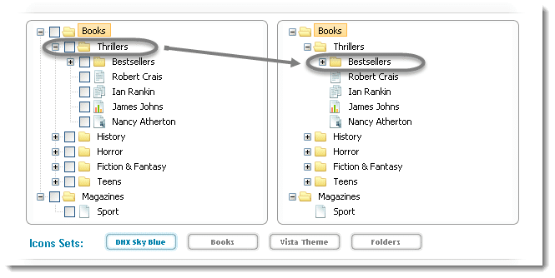
Drag and Drop action
This action is used to drag an item from one location to another location.
Example 1: In this example we will drag the Thriller folder from the left table on to the Bestsellers folder of the right side table.

Slide 48
Drag and Drop action
String URL = "http://www.dhtmlx.com/docs/products/dhtmlxTree/index.shtml";
driver.get(URL);
driver.manage().window().maximize();
driver.manage().timeouts().implicitlyWait(10000, TimeUnit.MILLISECONDS);
WebElement From = driver.findElement(By.xpath(".//*[@id='treebox1']/div/table/tbody/tr[2]/td[2]/table/tbody/tr[2]/td[2]/table/tbody/tr[1]/td[4]/span"));
WebElement To = driver.findElement(By.xpath(".//*[@id='treebox2']/div/table/tbody/tr[2]/td[2]/table/tbody/tr[2]/td[2]/table/tbody/tr[2]/td[2]/table/tbody/tr[1]/td[4]/span"));
Actions builder = new Actions(driver);
Action dragAndDrop = builder.clickAndHold(From) .moveToElement(To) .release(To) .build();
dragAndDrop.perform();

Slide 49
Mouse Hover action
driver.get("http://www.onlinestore.toolsqa.wpengine.com");
WebElement element = driver.findElement(By.linkText("Product Category"));
Actions action = new Actions(driver);
action.moveToElement(element).build().perform();
driver.findElement(By.linkText("iPads")).click();

